Slide 1
Career Development Training Course
Fleet Reserve and Retirement

Slide 2
Enabling Objectives
STATE the purpose of the Fleet Reserve
IDENTIFY personnel eligible for Fleet Reserve and retirement
IDENTIFY the duties credited towards Active Service in the Armed Forces
IDENTIFY the submission requirements for Fleet Reserve and Retirement requests
IDENTIFY the non-disability Fleet Reserve retirement procedures
IDENTIFY transition requirements
IDENTIFY how the Date Initial Entry Military Service (DIEMS) affects retirement
LIST the military retirement plans in effect
IDENTIFY the steps to compute retainer pay
IDENTIFY the steps for applying for Fleet Reserves and Retirement in NSIPS
Notes:
FACILITATOR GUIDE:
Review objectives.

Slide 3
References
MILPERSMAN 1810-010, Voluntary Retirement Of Enlisted Personnel – 30 Or More Years Of Active Service
MILPERSMAN 1830-040, Transfer To Fleet Reserve And Release From Active Duty – 20 Years
MILPERSMAN 1800-020, Effective Date Of Retirement, Issuance Of Retirement Orders And Authorization
MILPERSMAN 1810-080, Enrollment In The Blended Retirement System
Military Compensation, Retired Pay:
https://militarypay.defense.gov/Pay/Retirement.aspx
MILPERSMAN 1810-081, Continuation Pay For Service Members Enrolled In The Blended Retirement System
Notes:
FACILITATOR GUIDE:
Review references.

Slide 4
References
Department Of Defense Financial Management Regulation (DoD FMR), Volume 7B Chapter 1
OPNAVINST 1900.2 (series), Transition Assistance Program
MyNavyHR website: https://www.mynavyhr.navy.mil/career-management/transition/transition-tap/
NAVADMIN 273/17, Implementation Of Retirements And Separations Functionality Within NSIPS
10 USC 8326 (30 Year Retirement)
10 USC 8330 (Fleet Reserve)
Notes:
FACILITATOR GUIDE:
Review references.

Slide 5
Fleet Reserve (FLTRES)
Provides an available reserve of experienced former members of the Regular Navy and the Naval Reserve who may be used to fill billets requiring experienced personnel in the initial stages of mobilization during an emergency or in war
Consists of military personnel who have completed 20 but less than 30 years of Active Service in the Armed Forces (ASAF)
Effective date of Fleet Reserve is the last day of the month, of the month requested after service requirements have been fully met
Guidance is in MILPERSMAN 1830-040
Notes:
FACILITATOR GUIDE:
Fleet Reserve - An enlisted member of the naval service who has completed a minimum of 20 years of active service in the armed forces may, at his/her request, be transferred to the Fleet Reserve.
Counselor assist with the following:
Initial screening to determine Sailors eligibility.
Help Sailors verify their statement of service.

Slide 6
Retirement
Consists of military personnel who have completed a minimum of 30 years of Active Service in the Armed Forces (ASAF).
Effective date of retirement is the 1st day of the month, after the month in which service requirements have been fully met.
Guidance is in MILPERSMAN 1810-010
Notes:
FACILITATOR GUIDE:
Additional Notes:
Release from active duty is effective on the day immediately preceding the effective date of retirement.
.
HYT mandated retirements, may only be deferred if the Service member is:
hospitalized due to non-elective circumstances (i.e., acute, grave, or life threatening condition)
medical board report has been accepted by the president of a physical evaluation board for disability evaluation processing

Slide 7
Fleet Reserve Eligibility Requirements
Complete 20 years of credible service (ASAF)
  MILPERSMAN 1830-040/ DOD FMR Volume 7B, Chapter 1
Complete current assignment or DOD tour
E-7/8/9 must serve 2 years in present paygrade
Those in HYT zone can compete for advancement (verify HYT with current MPM and NAVADMINs)
Notes:
FACILITATOR GUIDE:
E-6: Can request 6-18 months from requested FLTRES date
E-7 to E-9: Can request 6-24 months from requested FLTRES date
Discuss creditable service:
The following is service creditable for Regular voluntary retirement for enlisted members:
All active service in the Uniformed Services; and
Service as a cadet or midshipman at Service academy

Slide 8
Non-Disability Fleet Reserve Retirement
Retirement from Fleet Reserve is automatic:
  (MILPERSMAN 1820-010)
Retired List: >30 Years (MILPERSMAN 1800-040):
  Permanent change of status and may only be changed by resignation or discharge approved by the SECNAV, or following a court-martial sentence.
Notes:
FACILITATOR GUIDE:
Review MPM prior to briefing slide.

Slide 9
Requesting Fleet Reserve
Requests for Transfer to Fleet Reserve/Retirement:
  Sailor submit request in RnS self service via NSIPS
Submit requests within the following timelines:
  E-6 and junior: 6–18 months prior to requested date or;
  E-7 and senior: 6-24 months prior to requested date
Extraordinary Heroism:
  Request entitlement to an additional 10% increase of retainer pay due to the performance of extraordinary heroism that is documented in personal awards i.e. Navy Cross, silver star, or awards with a “V” for valor.
Messages from BUPERS 836:
  Approval will be forwarded NLT 120 days prior to requested date via NSIPS on Member’s Fleet Reserve Request (attachments section).
Notes:
FACILITATOR GUIDE:
E6 and below: 6–18 months prior to requested Fleet Reserve date
E7 and above: 6-24 months prior to requested Fleet Reserve date
Retirement requests should be submitted 24 months prior to requested Retirement date
Additional Notes:
All messages will be available in NSIPS
Approval can be used to complete any OBLISERV requirements to reach the authorized Fleet Reserve/Retirement date.

Slide 10
Fleet Reserves and Retirement submission timeline
Fleet Reserve/Retirement (24-6 months)
E9
Transition
Fleet Reserve (24-6 months)
E8
Fleet Reserve (24-6 months)
E7
Fleet Reserve/Retirement Timeline
Fleet Reserve (18-6 months)
E6
Assist in verifying eligibility, complete initial counseling for TAP NLT 365 days prior to requested transition date, determine Tier, initiate eform
CCC
Notes:
FACILITATOR GUIDE:
Ensure to review current NAVADMINS/MPM for current HYT dates
Fleet Reserve
E6 can submit for 20 years with current HYT out to 22 years
E7 can submit for 20 years with current HYT out to 24 years
E8 can submit for 20 years with current HYT out to 26 years
E9 can submit for 20 years with current HYT out to 30+ years based on Master Chief or CMC position in the fleet. If over 30 years then apply for Retirement not Fleet Reserve.

Slide 11
Knowledge Check
When is initial counseling required?
How early can a Sailor request transfer to the Fleet Reserve?
What are the mandatory TAP requirements?
In what system does a Sailor request Fleet Reserve/Retirement?
What is the effective date of Fleet Reserves and Retirement?
Notes:
ANSWERS:
365 days or more prior to release date from active duty
6-18 months out (E-6); 6-24 months out (E-7 through E-9)
Initial counseling, Pre-separation counseling, TAP DOL workshop, Capstone
NSIPS R&S
Fleet Reserves is end of month and Retirement is on the first of the following month for Master Chiefs at 30+ and Officers

Slide 12
Career Development Training Course
Fleet Reserve and Retirement
Types and Pay

Slide 13
Date Initial Entry Military Service (DIEMS)
Critical date:
  Determines your retirement plan
Date first enlisted/commissioned into any component of the armed forces:
  Has no bearing on longevity for pay or years of service.
  Should never change; not adjusted for broken time or time lost.
Notes:
FACILITATOR GUIDE:
None.

Slide 14
Types of Retirement Plans
Retirement Plan | Criteria to Receive
Final Pay | Entry before September 8, 1980
High-36 | Entry on or after September 8, 1980, but before August 1, 1986 OR Entered on or after August 1, 1986, and did not choose the Career Status Bonus and REDUX retirement system
CSB/REDUX | Entered on or after August 1, 1986, but before January 1, 2003 AND elected to receive the Career Status Bonus
Blended Retirement System (BRS) | Entered the Uniformed Services for the first time on or after January 1, 2018 (automatic enrollment), or entered before December 31, 2017 and elected to opt into BRS during the opt-in period
Disability | Determined medically unfit for continued service with a DoD disability rating of at least 30%
Retirement Calculators are found at: https://militarypay.defense.gov/Calculators/
Notes:
FACILITATOR GUIDE:
Review retirement plans.
1. Final Pay: Defined Benefit that equals 2.5% times the number of years of service times the member’s final basic pay on the day of retirement.
2. High-36: Defined Benefit that equals 2.5% times the number of years of service times the average of the member’s highest 36 months of basic pay.
3. Redux: Career Status Bonus $30,000 lump sum payment at 15th year of service with obligation to serve through 20 years + defined benefit.
Defined Benefit is:
(a) Prior to age 62: 2.5% times the number of years of service minus 1.0% for each year of service less than 30, times the average of the member’s highest 36 months of basic pay
(b) At age 62 and after: 2.5% times the number of years of service times the average of the member’s highest 36 months of basic pay
4. BRS: Blended defined benefit and defined contribution plan.
Defined Contribution:
All covered members receive a Government contribution that equals 1% of basic or inactive duty pay to a tax-advantaged retirement account (Thrift Savings Plan (TSP)) after 60 days following the entry into Uniformed Service. Additionally, covered members have the ability to receive up to an additional 4% matching contribution from the Government to TSP beginning after 2nd year of service through 26th year of service.
Defined Benefit:
Members who otherwise qualify for a retirement based on longevity of service will also receive a defined benefit that is 2.0% times the number of years of service times the member’s highest 36 months of basic pay.
4. Disability: Retirement plan that equals to: Retired Pay Base* times Multiplier %**
*Retired Pay Base – determined under Final Pay, High-36, or BRS depending on military service date of entry.
**Multiplier Percentage can be either:
Member’s percentage of disability determined by the military service
Years of creditable service times 2.5% or 2.0% (Based on whether the member was a participant in one of the legacy retirement programs or the Blended Retirement System prior to the disability)
Note that in both cases the multiplier is limited to 75% by law

Slide 15
Retired Pay
High Three
BRS
HIGH 3
DIEMS on or after 8 Sep 80
2 1/2% x BP (36 mos. avg.) x ASAF = RP (DTC)
2.5% every year over 20 years
BLENDED RETIRMENT SYSTEM
DIEMS on or after 1 JAN 18
2% x BP (36 mos. avg.) x ASAF = RP (DTC)
TSP contribution up to 5%
2% every year over 20 years
Continuation Pay
  Eligible prior to reaching 12 years
Notes:
FACILITATOR GUIDE:
Continuation Pay. Designed to incentivize Service members to obligate for an additional 4 years of service until eligibility for a regular or non-regular retirement:
Eligible prior to reaching 12 years
One-time mid-career incentive pay in exchange for an agreement to perform 4 years of additional obligated service
NSIPS sends notification 6 months, then at 90 days prior to the CP date, reminding members that they are coming up on the CP election deadline.
After 12 years are no longer eligible
Service members have two options for CP payment:
(1) Lump sum or
(2) In a series of equal installment payments, not to exceed 4 annual payments occurring over 4 consecutive years.
The effective date of payment will be the 12th year anniversary of a Service member’s PEBD.

Slide 16
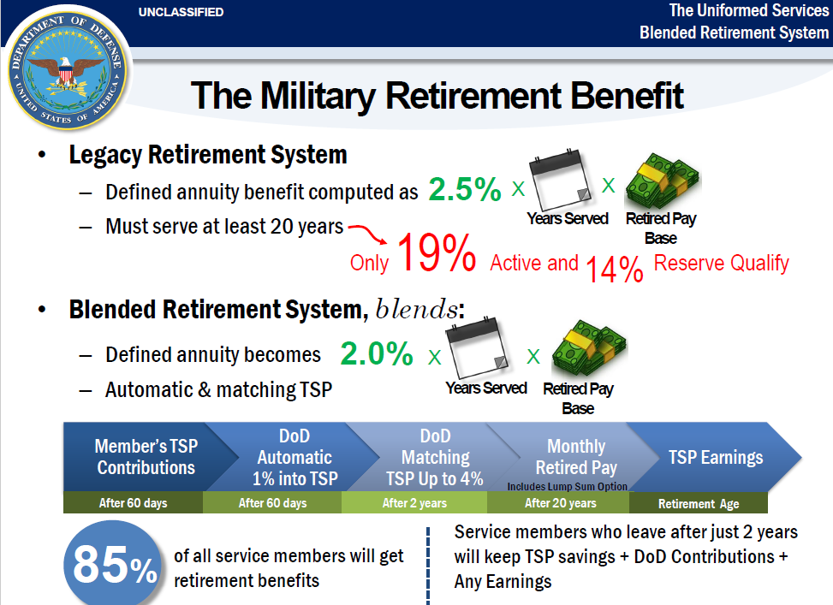
Notes:
FACILITATOR GUIDE:
Visual of current retirement systems.

Slide 17
Military Retirement Comparisons
Years of Service “Final/High 3” “BRS” % REDUX%
20 50 40 40
21 52.5 42 43.5
22 55 44 47
23 57.5 46 50.5
24 60 48 54
25 62.5 50 57.5
30 75 60 75
35 87.5 70 87.5
40 100 80 100
41 102.5 82 102.5
Notes:
FACILITATOR GUIDE:
Review chart.

Slide 18
Retirement Ceremonies
MILPERSMAN 1800-010
Ceremony:
  Is a Sailor’s choice
  Is sponsored by Sailor’s last permanent duty station
  Is assigned a ceremony coordinator
  Is official and traditional
CCC responsibilities:
  Make sure all documents are prepared
  Make sure command issues U.S. flag
    Authorized to use OPTAR funds to procure flags
  Make yourself available to coordinator
Notes:
FACILITATOR GUIDE:
None.

Slide 19
Knowledge Check
What determines a Sailor’s retirement plan?
When are Sailors eligible for continuation pay?
Which retirement plans are Sailors currently enrolled in?
Commands are authorized to use what funding to procure flags for Sailors transferring to the Fleet Reserve or Retired list?
Notes:
ANSWERS:
DIEMS date
Eligible prior to reaching 12 years
High 3 and BRS
OPTAR

Slide 20
Submitting Fleet Reserve/Retirement in NSIPS
Notes:
FACILITATOR GUIDE:
If able, bring up NSIPS to walk through and show the system for submitting Fleet Reserve/Retirement request or use slides and explain the process.

Slide 21
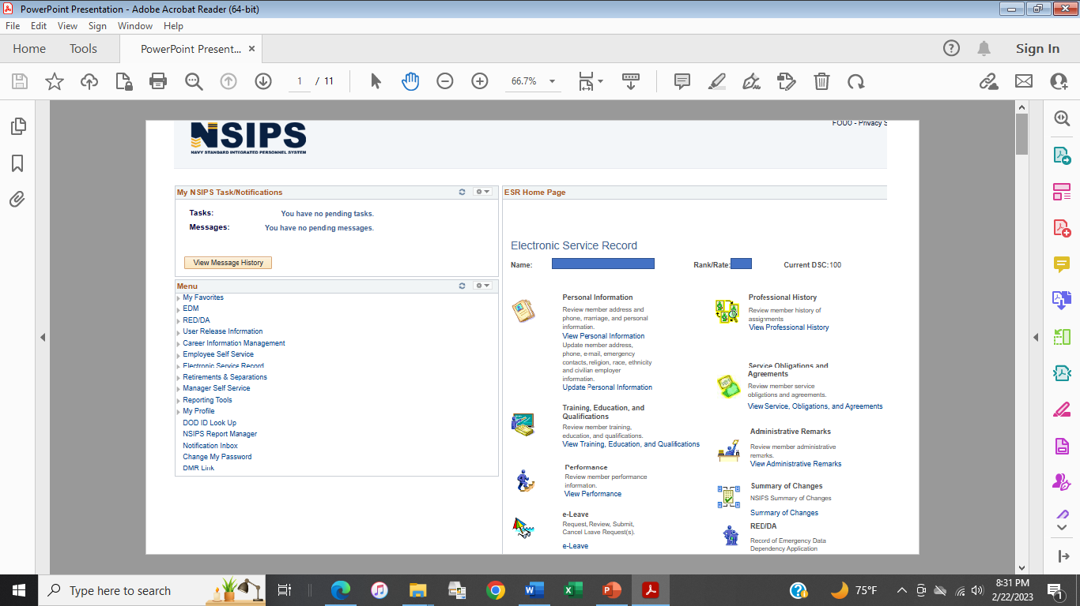
Notes:
FACILITATOR GUIDE:
Log into NSIPS if able and walk through the site as if applying for Fleet Reserves or Retirement.
Prior to applying for Retirements & Separations in NSIPS:
Click on employee Self Service to first update address and phone information in the steps on the next few slides
Steps for applying:
Click on Retirement & Separations.

Slide 22
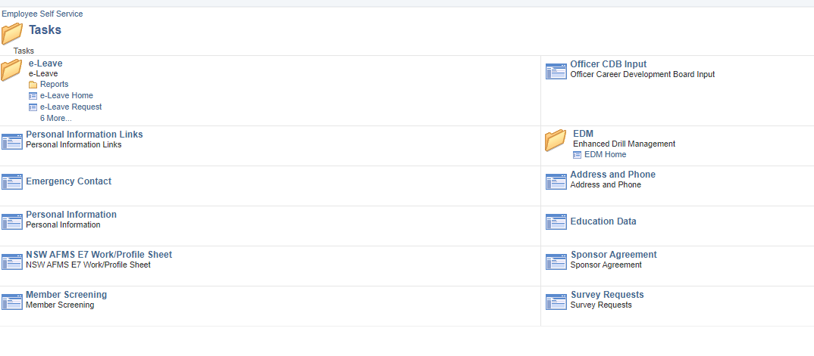
Notes:
FACILITATOR GUIDE:
Click on address and phone
Then you will hit the + sign and follow directions in next slide

Slide 23
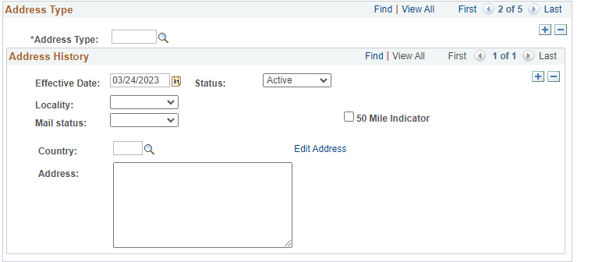
Notes:
FACILITATOR GUIDE:
To start filling out your address you will click on the magnify glass
Once it comes up you will scroll down and click on PSA (Planned Separation) *list is shown in next slide
After selecting PSA the member can complete address update by clicking edit address
NOTE: If the Sailor does not update the address prior to completing the request. Once they begin the process they will receive a message saying “Please enter a valid Planned Retirement/Separation Address, Phone, or Email link.” (Contact Information). At this time they can enter their PSA information.

Slide 24
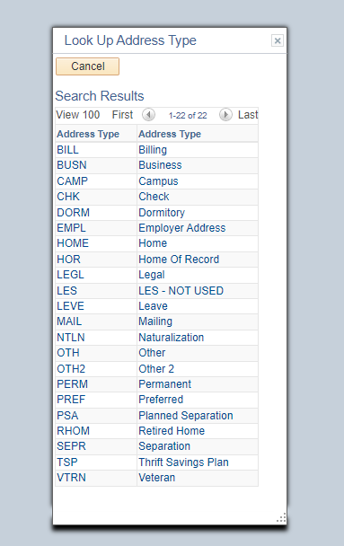
Notes:
FACILITATOR GUIDE:
This slide shows the different types of addresses the Sailor can chose from. The member will select, PSA Planned Separation.

Slide 25
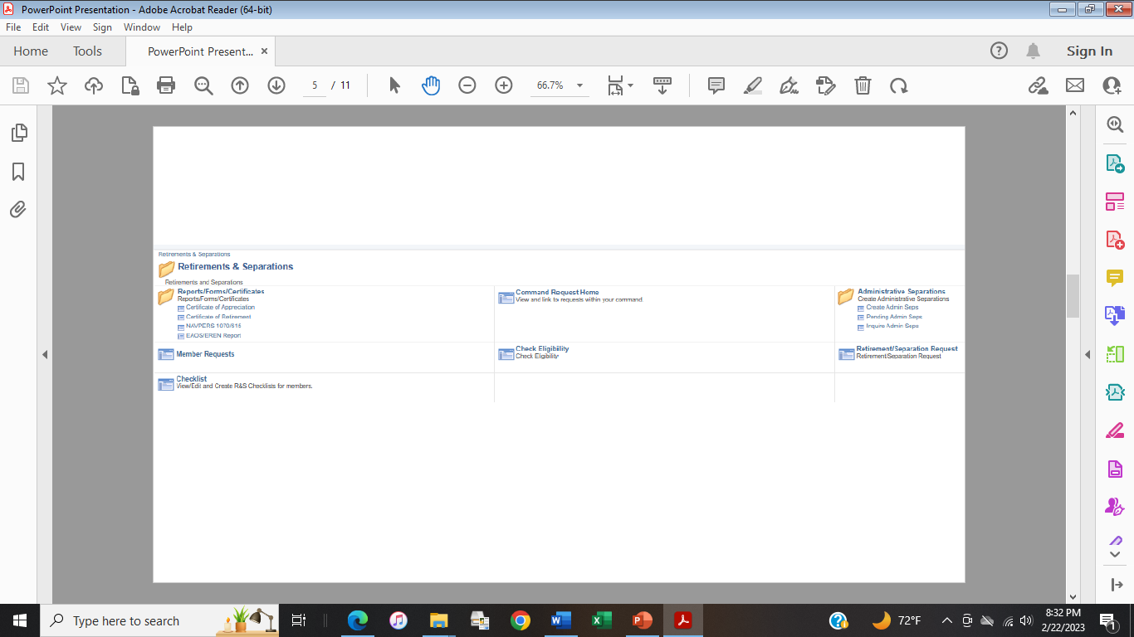
Notes:
FACILITATOR GUIDE:
Once the Address Phone is updated. Click on Retirement/Separation Request
The following slides explain the steps for submitting request in NSIPS

Slide 26
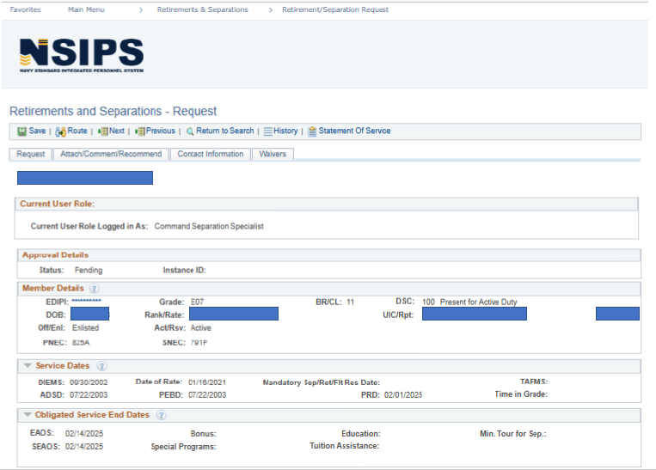
Notes:
FACILITATOR GUIDE:
This page will appear once you click on Retirement/Separation Request.
Discuss the tabs going across from Save, Route, Next, Previous, Return to Search, History, Statement of Service (not listed is Reference Material and Modify/Cancel which will show up on members request).
Route:
Will give the member the ability to route request to Command Separation Specialist or Command Reviewer depending on how routing is set up for command
Command Separation Specialist will route based on command routing process
Reporting Senior will route to NPC for processing
Statement of Service will give member break down of total service
Explain the tabs for Request, Attach/Comment/Recommend
Upload Attachments:
This tab gives the member the ability to attach supporting documents to support any waivers or anything that is significant for their request. This is the same area the member will find the Approval Letter.
Comments and Recommendations:
This tab allows members of COC to input comments and recommendations on the members request. It also shows the user role and who made the comment on the request.
Contact Information:
This tab will show contact information that was updated prior to applying for Retirement/Separation.
Command Contact Information will be the person who will be contacted regarding the request. This is normally the Command Career Counselor or Command Separation Specialist.
Reporting Senior will be the Commanding Officer or Officer in Charge.

Slide 27
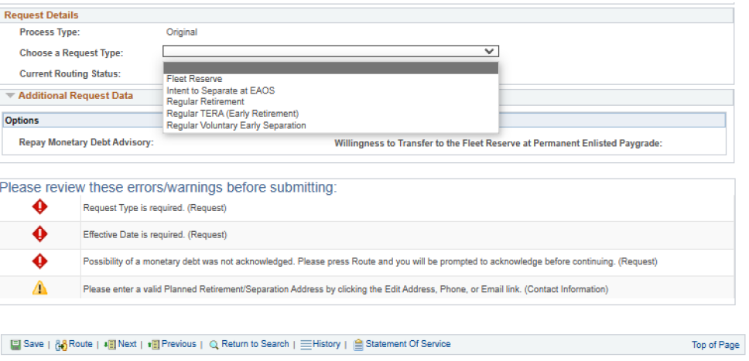
Once you Choose a Request Type the errors/warnings below will change based on type of request as you will see in the following slides.
Notes:
FACILITATOR GUIDE:
Once you scroll down to fill out the request you will come to “Request Details.” “Request type” will determine the errors/warnings you will receive.
The following slides are examples of different errors/warnings a Sailor will see based on their request type.
Note: Explain the errors/warnings will change as the member fills out the request.

Slide 28
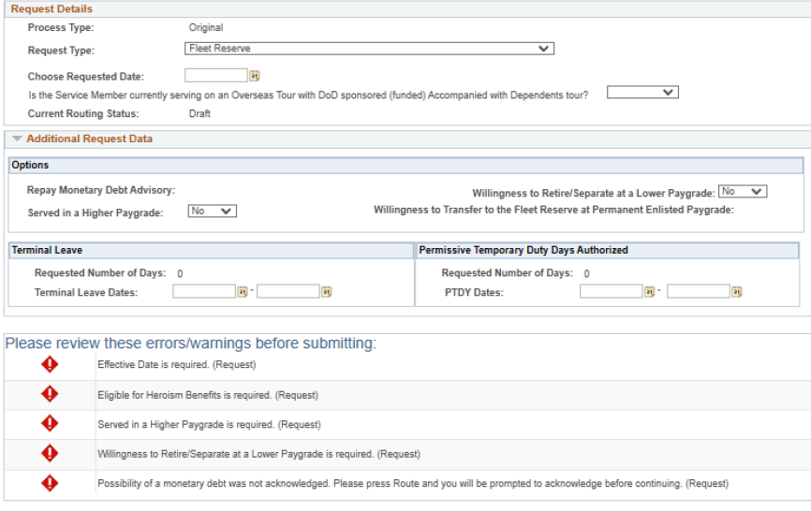
Notes:
FACILITATOR GUIDE:
Once you select a request type; fill out the blocks that pertains to the request .
As you start to fill out the request some errors/warnings will turn green with a check mark or a yellow triangle with exclamation mark.
Note: Until the member completes the request and routes it; it will stay in members record as a draft. When the request is in "draft mode" it can only be edited by the member but can be viewed by the Command Separation Specialist.
Note: Explain the errors/warnings will change as the member fills out the request.

Slide 29

Notes:
FACILITATOR GUIDE:
Note: Please ignore the eligibility results on this slide since the EAOS/SEAOS are too far out to submit request.
The purpose of this slide is to show how any errors/warnings for the request will be listed at the bottom of the page.
Note: Explain the errors/warnings will change as the member fills out the request.

Slide 30

Notes:
FACILITATOR GUIDE:
Errors/Warnings
Member will receive a “Failed Eligibility” if the request submitted is outside of members window for applying.
Note: Possibility of Monetary debt was not acknowledged. Press "Route" and you will be prompted to acknowledge before continuing.
- Explain that this error may apply to Sailors based off of leave sell back, debt for any previous travels not completed, or if member may be under/overpaid for the month if retirement/separation.
Note: Error/warning - Requested date occurs after EAOS (MM/DD/YYYY) and SEAOS (MM/DD/YYYY) dates.
-With this error a member may require more service on contract to meet retirement or fleet reserve date. Explain the process the Sailor will complete with the CCC if this comes up i.e., extension process.

Slide 31
Cancel or Modify Request
To cancel or modify a previously approved request processed in NSIPS RnS, the member will access the request and select either "modify" or "cancel" and reroute accordingly.
To cancel or modify a previously approved request processed through NSIPS CIMS, CCCs should email an approved/signed Personnel Action Request (1306/7) to Enlisted_Active_Duty_Retirements@navy.mil for processing.
Notes:
FACILITATOR GUIDE:
None.

Slide 32
Summary and Review
In this lesson we discussed:
  Fleet Reserve and retirement purpose and eligibility
  Creditable service
  Submission of Fleet Reserve/Retirement request
  Non-disability Fleet Reserve retirement procedures.
  LIST the factors affecting retirement pay.
  DIEMS effects on retirement.
  Current military retirement plans
  Computed retainer pay for the two retirement systems.
  TAP requirements.

Slide 33

Fleet Reserve and Retirement

